Slide 1
Vocabulary
Focus upon effective and appropriate use of vocabulary.
Children use thesauruses to ‘up-level’ vocabulary.
National Curriculum expects year 4 pupils to understand grammatical terminology, identify and use in their writing.
Fronted adverbials
Prepositions
Conjunctions
Tense
Noun phrases
Adverbs
Adjectives

Slide 2
Times tables
Children complete a times table challenge daily, assessing their progress and understanding.
The times tables they are currently using are the ones they should be practising at home – The children will know what this is!
They will also complete the 99 Club challenge weekly, and a multiplication grid every half-term – This challenges their rapid recall of all times tables and division facts.
Year 4 children are expected to know multiplication and division facts up to their 12 times tables.
This is the first year group to receive the new statutory times table assessment, following the postponement in the summer term due to school closures.

Slide 3
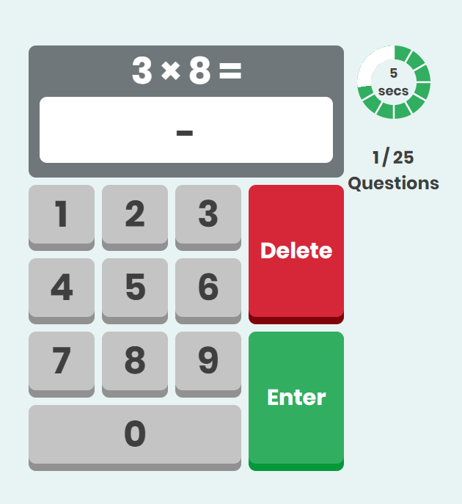
Practise times tables on Purple Mash

Slide 4
Maths in Year 4
Addition and subtraction in Year 4
Pupils should be taught to:
add and subtract numbers with up to 4 digits using the efficient written methods of columnar addition and subtraction where appropriate.
estimate and use inverse operations to check answers to a calculation.
Solve addition and subtraction two-step problems in contexts, deciding which operations and methods to use and why.

Slide 5
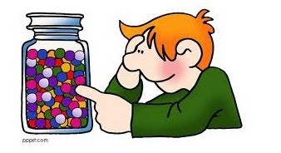
354 + 576 = 930
354
₊ 576
930
1 1
E = 350 + 580 = 930

Slide 6
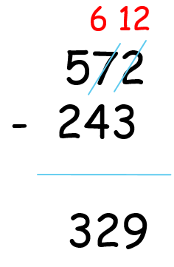
572 – 243 =
E: 570 – 240 = 330

Slide 7
Multiplication and division in Year 4
Pupils should be taught to:
recall multiplication and division facts for multiplication tables up to 12 × 12.
use place value, known and derived facts to multiply and divide mentally, including: multiplying by 0 and 1; dividing by 1; multiplying together three numbers.
recognise and use factor pairs and commutativity in mental calculations.
multiply two-digit and three-digit numbers by a one-digit number using formal written layout.
Solve problems involving multiplying and adding, including using the distributive law and harder multiplication problems such as which n objects are connected to m objects.

Slide 8
Grid method (Multiplication)
Bus-stop (Long/short division)
42 x 3
= 126
96 ÷ 4
= 24
2
4
40
2
1
4
9 6
3
120
6
120 + 6 = 126

Slide 9
Home Learning
Currently we encourage children to read, learn their times tables and their spellings at home each week.
Further into this half term we will also be setting a Purple Mash activity for the children to complete at home, linked to an area of study in the wider curriculum.
This will replace the A4 sheet of activities that you will have received half termly in previous year groups.
If you are unable to access the internet at home, please speak to your child’s class teacher.

